Slide 1

PRINCIPLES OF MANAGEMENT

Slide 2
PROJECT
IMPACT OF SOCIAL MEDIA

Slide 3
OVER VIEW
ABSTRACT
INTRODUCTION
SOCIAL NETWORKING SITES
USES
IMPACT OF SOCIAL MEDIA
SURVEY
METHODS
CONCLUSION

Slide 4
ABSTRACT
Social media plays a very important role in one’s life. Billions of people use social media to share information and to connect with people. It is easy to connect with people but it will impact on the communication between the people. As per studies, social media contains 30% of good knowledge and the remaining 70% is completely filled with unwanted stuff.

Slide 5

introduction
Social Media is the collection of online communication channels.
It is dedicated to community-based input interaction content sharing and collaboration.

Slide 6
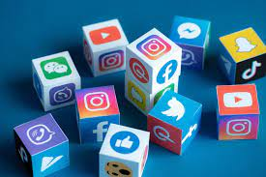
LIST OF SOCIAL NETWORKING SITES
Facebook
Twitter
YouTube
Instagram
WhatsApp
Linkdin

Slide 7

USES OF SOCIAL MEDIA
To stay in touch with what friends are doing.
To stay up-to-date with news and current events.
To fill up spare time.
To find funny or entertaining content.
To share opinions.

Slide 8
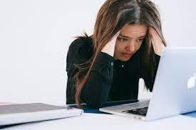
IMPACT OF SOCIAL MEDIA
Health
Education
Youth
Society

Slide 9
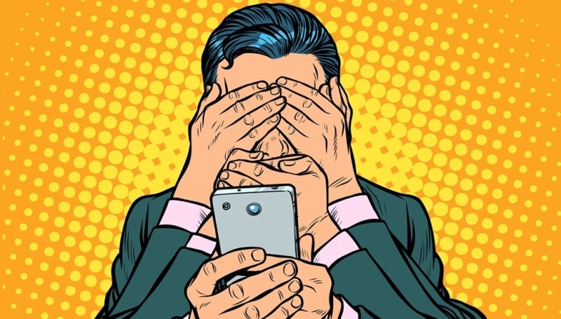
IMPACT OF SOCIAL MEDIA ON EDUCATION
Media make student dull and lazy
Time consuming
The physical and emotional imbalance of student

Slide 10
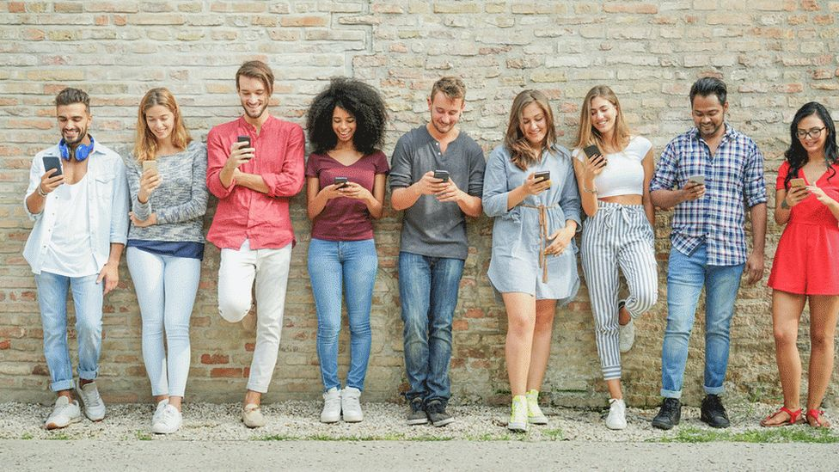
IMPACT OF SOCIAL MEDIA ON SOCIETY
Technology has come a long way from its existence.
Social media make lives of many easier
With social media any person has ability to be a big deal and can influence other

Slide 11

IMPACT OF SOCIAL MEDIA ON POLITICS
Voter participation is increased. Facebook users are said they are more likely to vote if they see that their online friends did.
Online networks give social movements a quick, cheap method of disseminating information and mobilizing people.

Slide 12
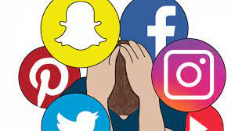
IMPACT OF SOCIAL MEDIA ON HEALTH
Stress
Emotional connection
Addiction to social media
Information

Slide 13
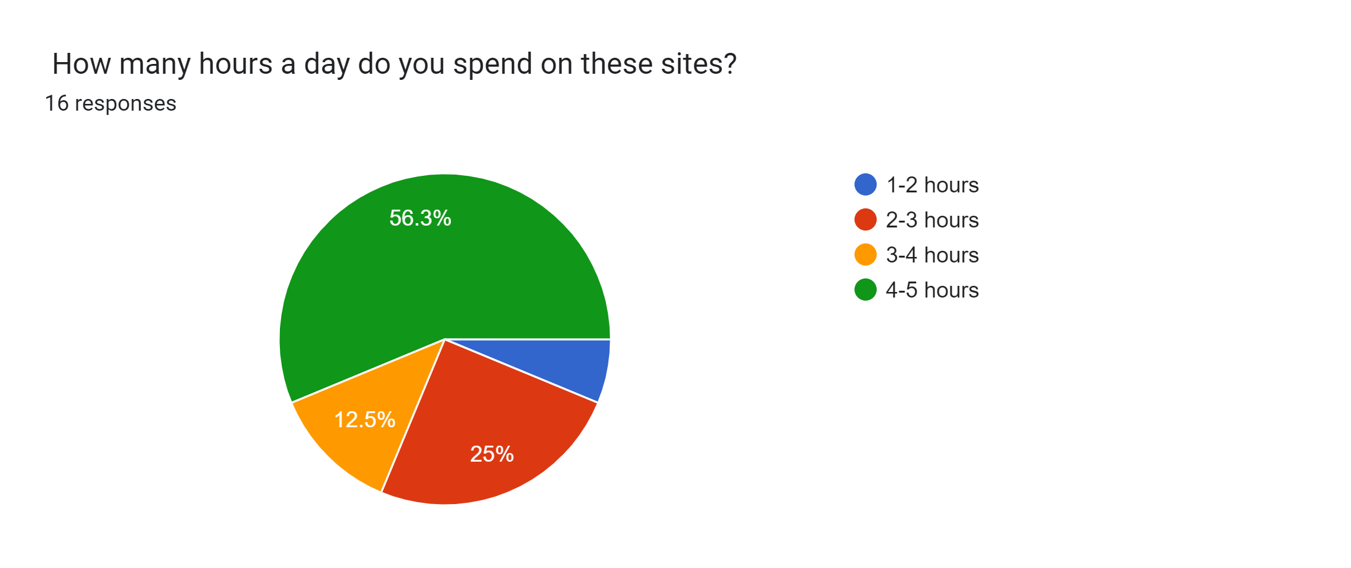
SURVEY

Slide 14
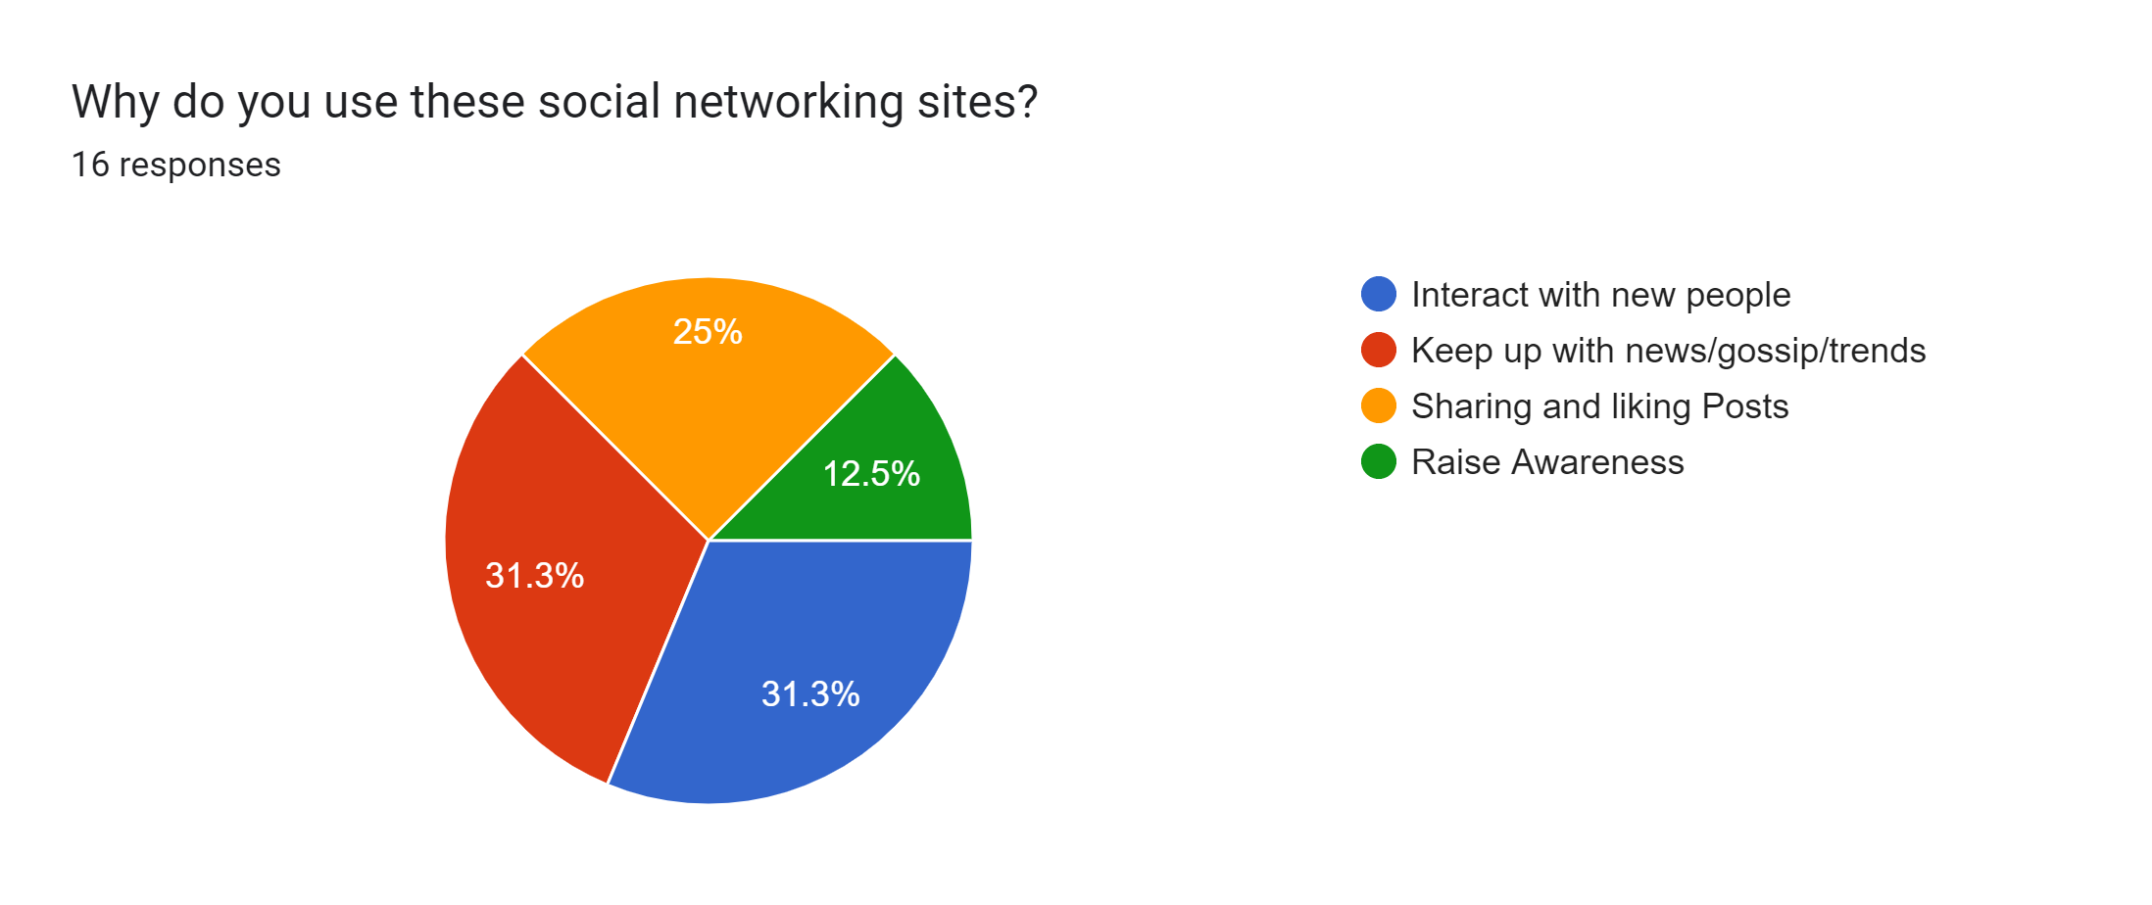

Slide 15
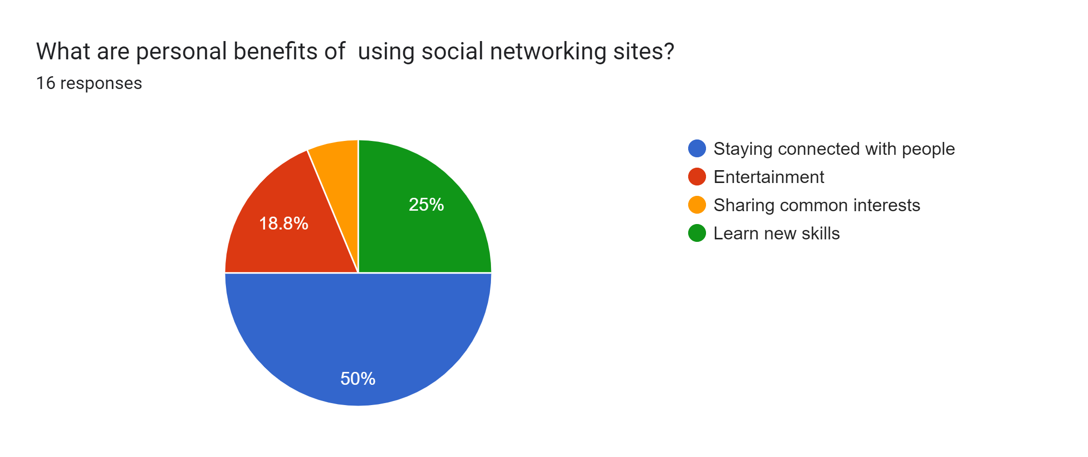

Slide 16
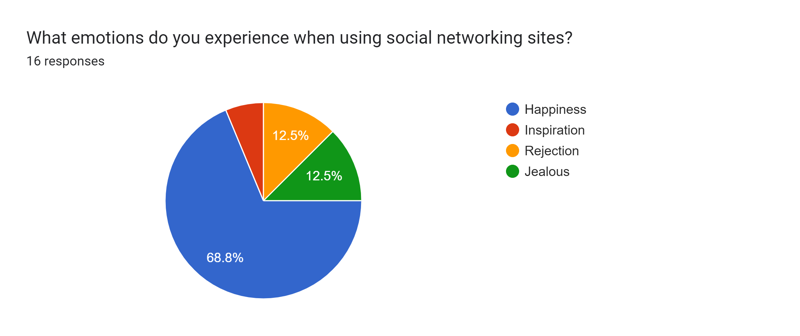

Slide 17

METHODS TO REDUCE IMPACT
Turn Off All app-based Notifications
Delete Apps / Social Media Accounts You Don’t Use
Limit Yourself
Avoid sleeping with mobile
Remove your phone from your morning routine
Take a break

Slide 18
CONCLUSION
As with most of the things in life there are positive and negative sides to social networking, both of which we have now explored. Our ultimate belief is that social networking sites are neither evil or godsend.

Slide 19


